Slide 1
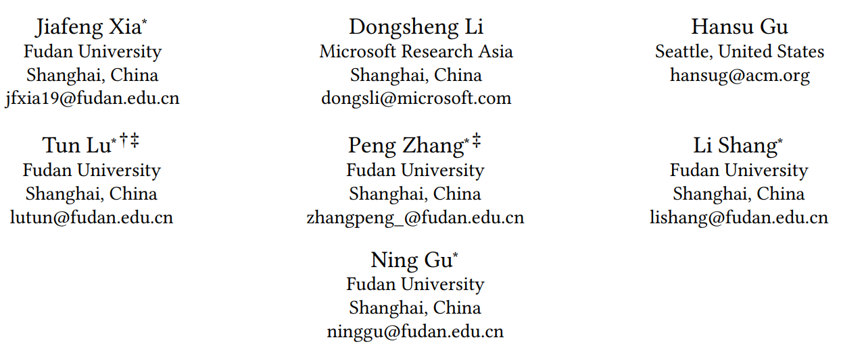
ATAI
Advanced Techniqueof Artificial Intelligence
ATAI
ChongqingUniversity _{AdvancedTechniqueof}
of Technology Artificial Intelligence
Chongqing University of
Technology
Chongqing University ^{ATAI}
_{of Technology} Advanced Techniqueof
Artificial Intelligence
Chongqing University of Technology
Chongqing University of Technology
Oracle-guided Dynamic User Preference Modeling for Sequential
Recommendation
Code: https://github.com/Yaveng/Oracle4Rec
2025.1.16•ChongQing
—— WSDM 2025
Reported by Shunan Yin
1

Slide 2
ATAI
AdvancedTechniqueof
Artificial Intelligence
ATAI
ChongqingUniversity _{AdvancedTechniqueof}
of Technology Artificial Intelligence
ChongqingUniversity of Technology
Motivation
(i). Most existing methods only use past information extracted from user historical interactions to train the models, leading to the deviations of user preference modeling.

Slide 3
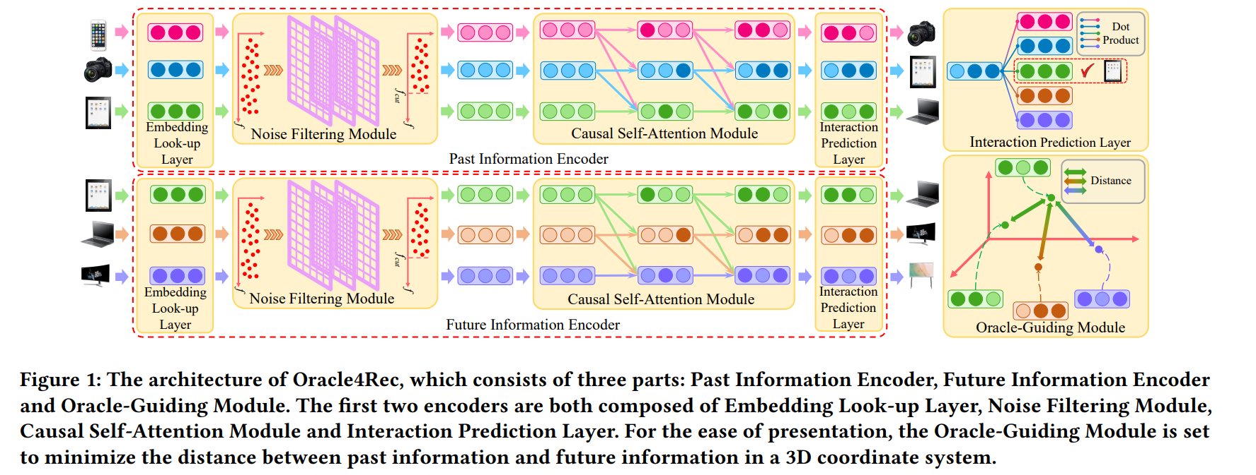
ChongqingUniversity of Technology
ATAI
AdvancedTechniqueof
Artificial Intelligence
ATAI
ChongqingUniversity _{AdvancedTechniqueof}
of Technology Artificial Intelligence
Overview

Slide 4
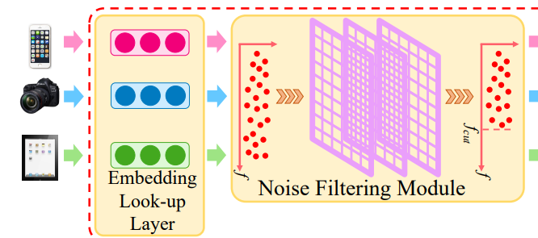
ChongqingUniversity of Technology
ATAI
AdvancedTechniqueof
Artificial Intelligence
ATAI
ChongqingUniversity _{AdvancedTechniqueof}
of Technology Artificial Intelligence
Method

Slide 5
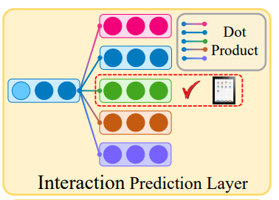
ChongqingUniversity of Technology
ATAI
AdvancedTechniqueof
Artificial Intelligence
ATAI
ChongqingUniversity _{AdvancedTechniqueof}
of Technology Artificial Intelligence
Method

Slide 6
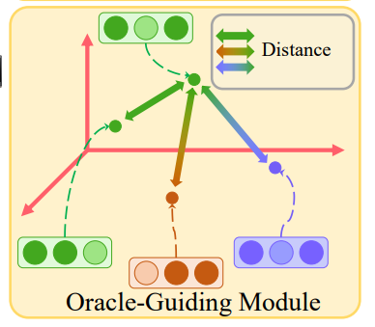
ChongqingUniversity of Technology
ATAI
AdvancedTechniqueof
Artificial Intelligence
ATAI
ChongqingUniversity _{AdvancedTechniqueof}
of Technology Artificial Intelligence
Method

Slide 7
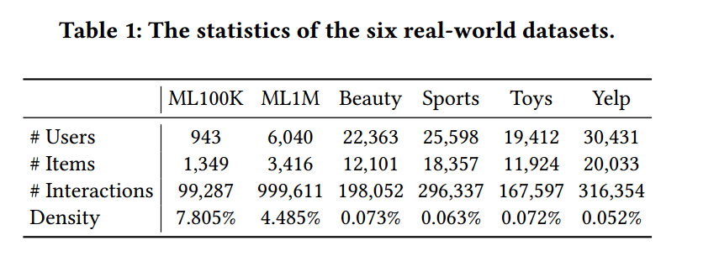
ATAI
AdvancedTechniqueof
Artificial Intelligence
ATAI
ChongqingUniversity _{AdvancedTechniqueof}
of Technology Artificial Intelligence
ChongqingUniversity of Technology
Experiments

Slide 8
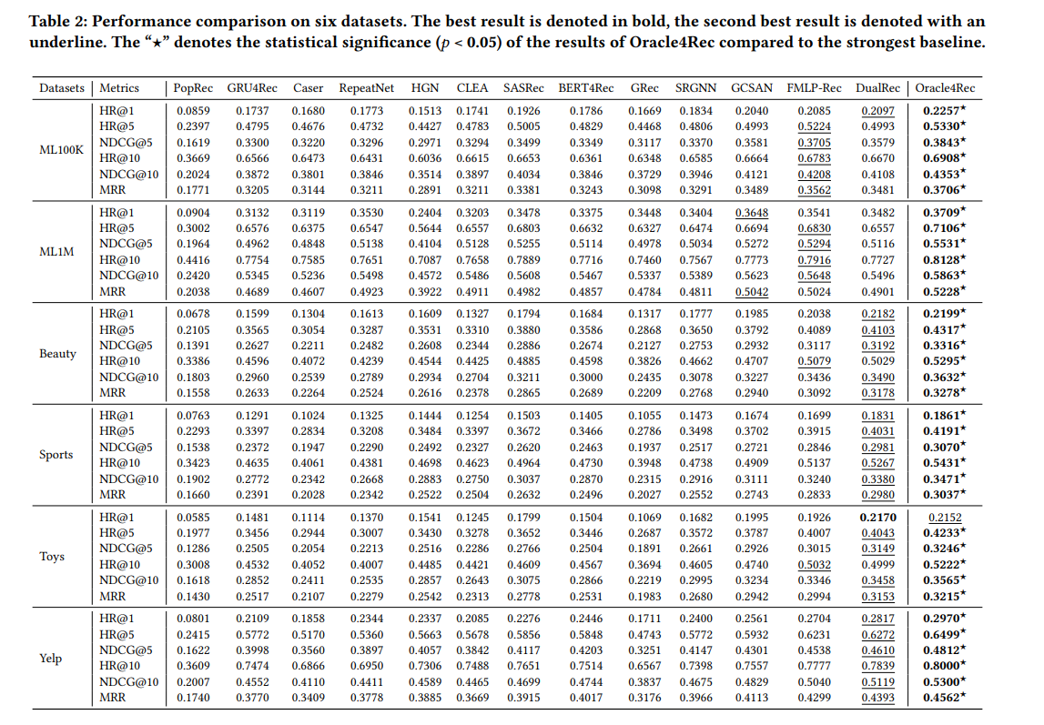
Experiments
ATAI
AdvancedTechniqueof
Artificial Intelligence
ATAI
ChongqingUniversity _{AdvancedTechniqueof}
of Technology Artificial Intelligence
ChongqingUniversity of Technology

Slide 9
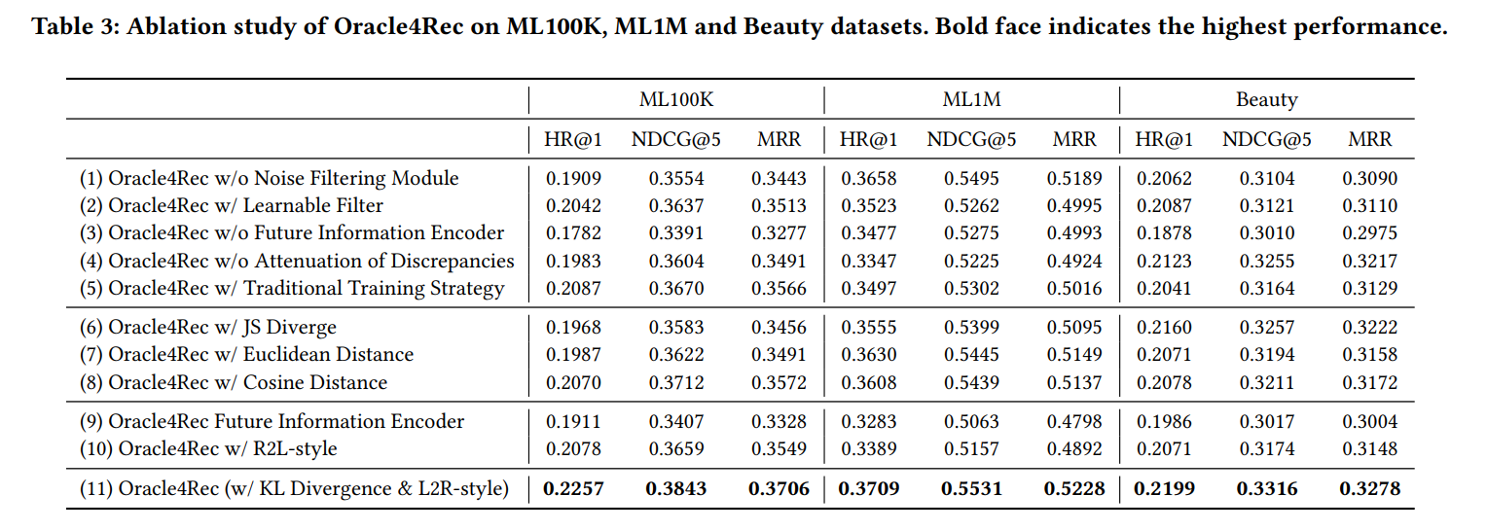
ATAI
AdvancedTechniqueof
Artificial Intelligence
ATAI
ChongqingUniversity _{AdvancedTechniqueof}
of Technology Artificial Intelligence
ChongqingUniversity of Technology
Experiments

Slide 10
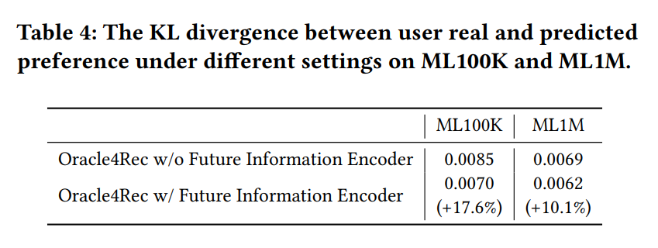
ATAI
AdvancedTechniqueof
Artificial Intelligence
ATAI
ChongqingUniversity _{AdvancedTechniqueof}
of Technology Artificial Intelligence
ChongqingUniversity of Technology
Experiments

Slide 11
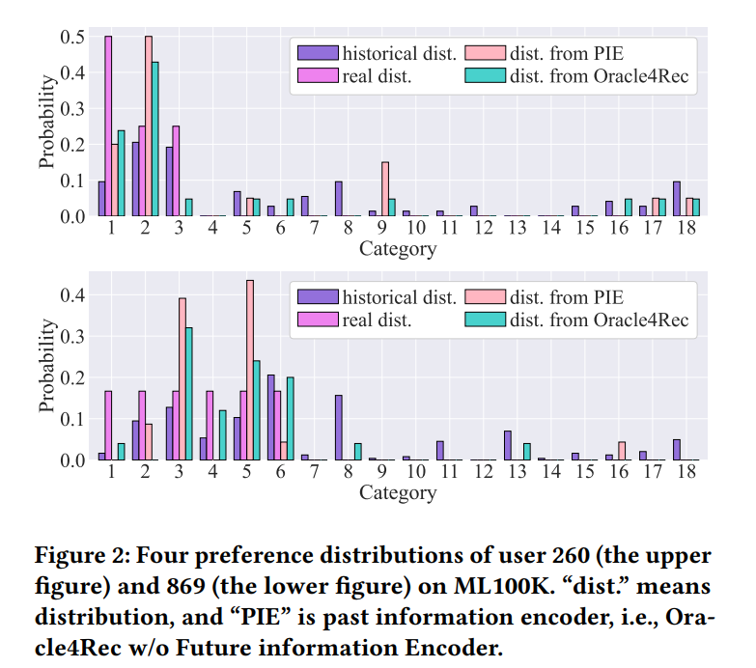
ATAI
AdvancedTechniqueof
Artificial Intelligence
ATAI
ChongqingUniversity _{AdvancedTechniqueof}
of Technology Artificial Intelligence
ChongqingUniversity of Technology
Experiments

Slide 12
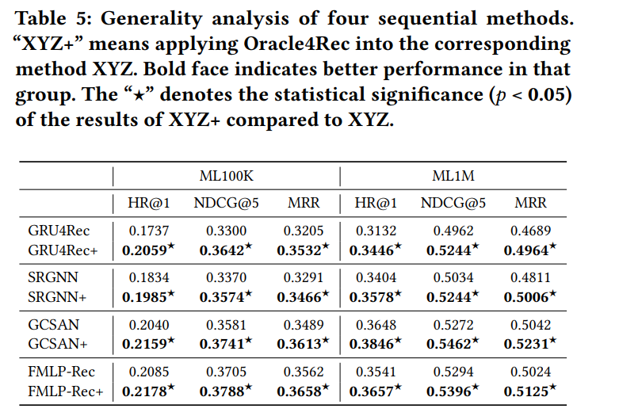
ATAI
AdvancedTechniqueof
Artificial Intelligence
ATAI
ChongqingUniversity _{AdvancedTechniqueof}
of Technology Artificial Intelligence
ChongqingUniversity of Technology
Experiments

Slide 13
ChongqingUniversity of Technology
ATAI
AdvancedTechniqueof
Artificial Intelligence
ATAI
ChongqingUniversity _{AdvancedTechniqueof}
of Technology Artificial Intelligence
Thanks!

